Slide 1
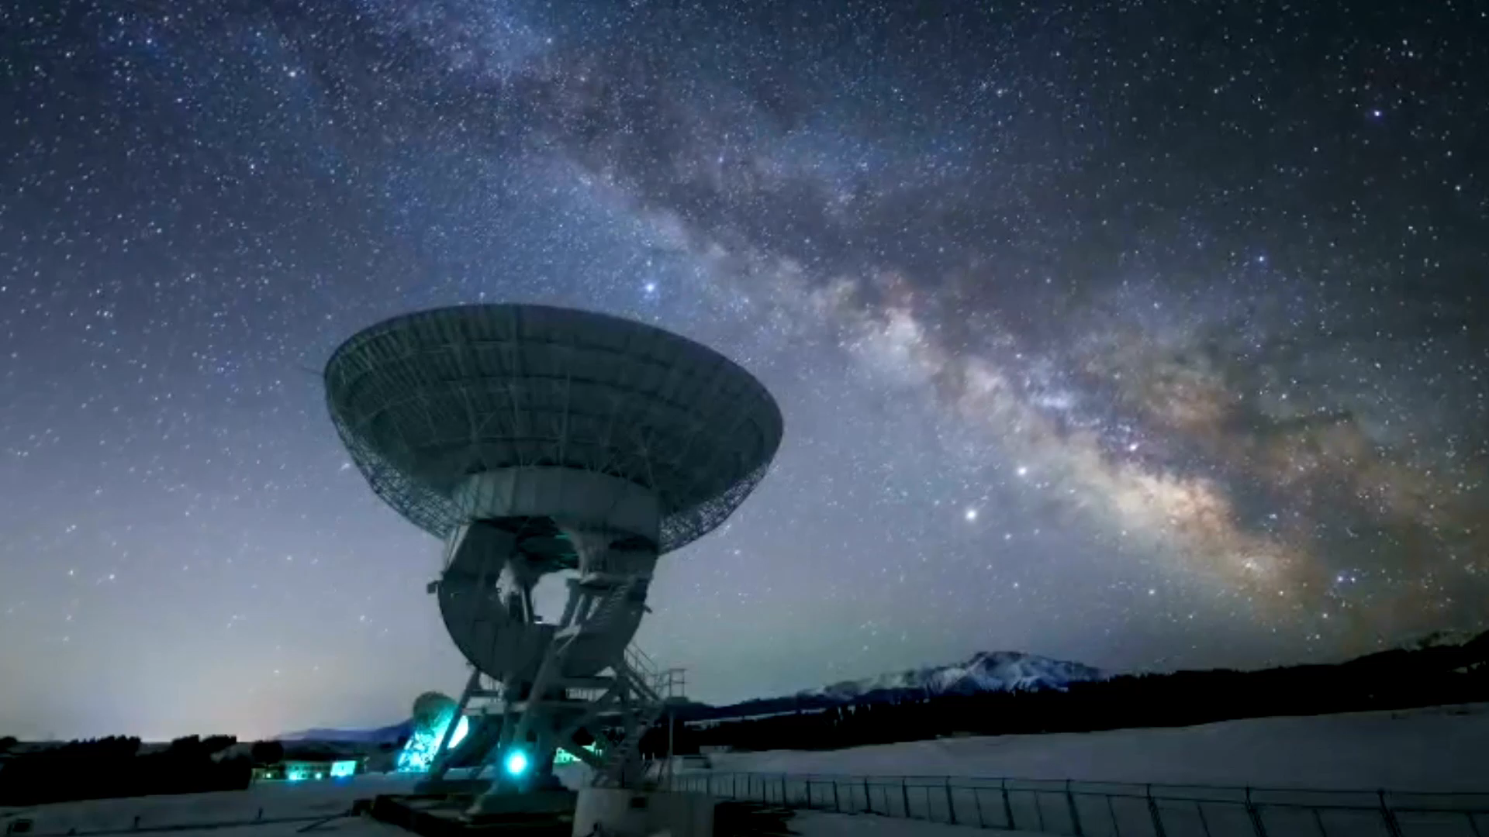
EED 374 Radar Engineering Delay Line Canceller(DLC)
Group members:
Dushyant Singh Satyapal : 2010111237
Suresh Kaistha: 2010110666
Abhijeet Singh Chahal: 2010110019
Prashant Kumar: 2010110871
Ishanay Sharma: 2010110750

Slide 2

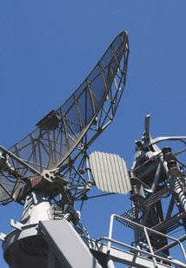
Introduction
Delay line cancellers are widely used in digital communication and radar systems to mitigate the effects of channel distortion and unwanted echoes or interference, respectively. In radar systems, a delay line canceller is a specific signal processing technique that removes unwanted echoes or interference from the received radar signal. The delay line canceller works by introducing a delay into the received signal, matching the delay of the unwanted echoes or interference, and subtracting the delayed signal from the original received signal. This cancels out the unwanted echoes or interference, leaving only the desired signal.

Slide 3

HOW DOES A DELAY LINE CANCELLER WORK? The output of the MTI radar is given as input to the delay line canceller. An analog-to-digital converter converts the input signal to its equivalent digital value. The signal is delayed, which is achieved by storing the radar output during the pulse transmission. The original signal and delayed version are then subtracted to produce an output signal free from echoes. The absolute value of the difference signal is then taken and fed to a digital-to-analog converter to produce the output signal.

Slide 4
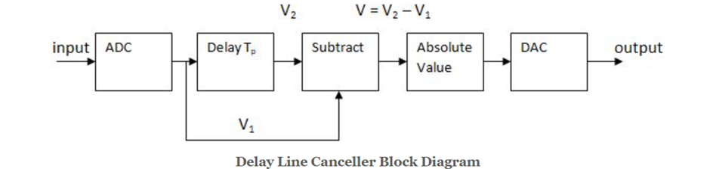
LAYOUT

Slide 5
Components
Analog to Digital Converter: converts analog signals into a digital representation.
Delay: delays the signal by some time.
Subtractor: subtract the original signal and delayed version to produce an output signal free from echoes.
Digital to Analog converter: Convert the absolute analog signal to digital signal(output signal).

Slide 6
Types of Delay Line Canceller
Delay line cancellers can be classified into types based on the number of delay lines.
Single Delay Line Canceller- A Single Delay Line Canceller (SDLC) is a type of delay line canceller that uses a single delay line to remove unwanted echoes and interference from a received signal.
Double Line Canceller- A Double Line Canceller (DLC) is a delay line canceller that uses two delay lines to remove unwanted echoes and interference from a received signal. The two delay lines are typically designed to introduce different delay times into the received signal, allowing for more precise cancellation of unwanted signals with varying delay times.

Slide 7
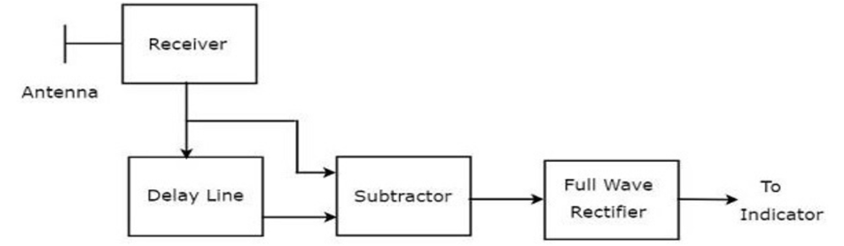
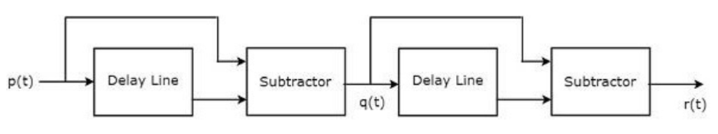
Comparison between Single DLC and Double DLC
Single DLC
Double DLC

Slide 8
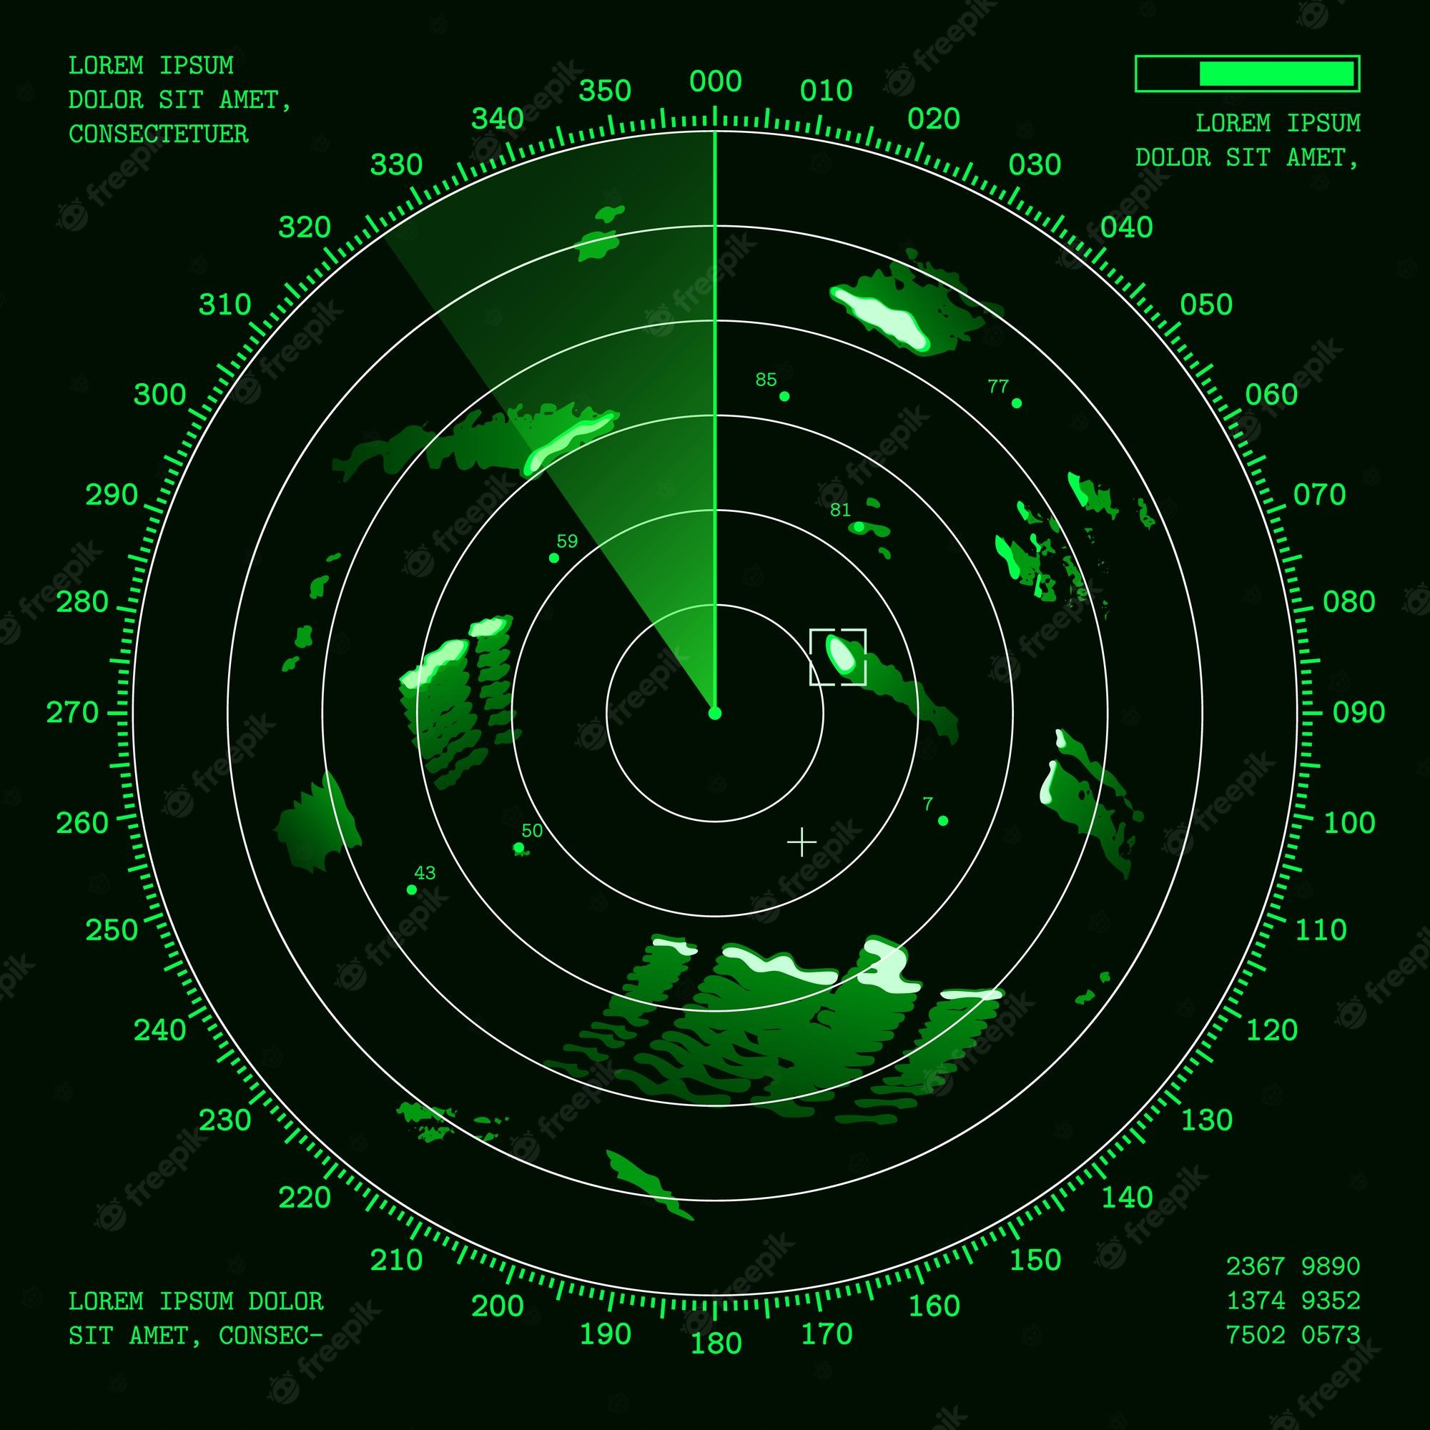
N Delay Line Canceller
We can make N line delay line canceller. In an N-Line Delay Line Canceller, the received signal is split into multiple paths, each passing through a different delay line with a different delay time. The delayed signals are then combined and subtracted from the original signal using a subtractor circuit.
Therefore in general-
N -Line Delay Line Canceller = (N+1) pulse canceller

Slide 9
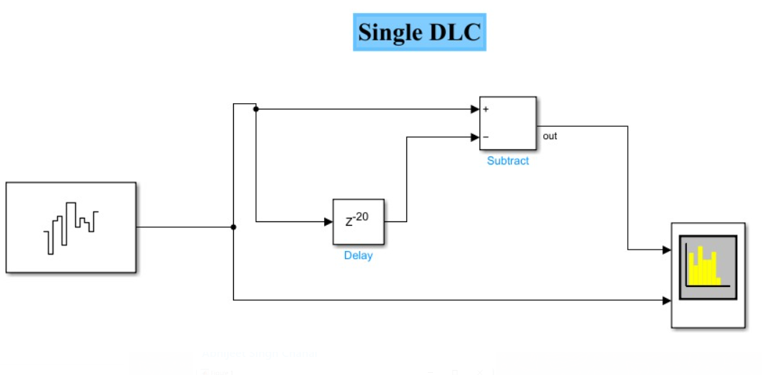
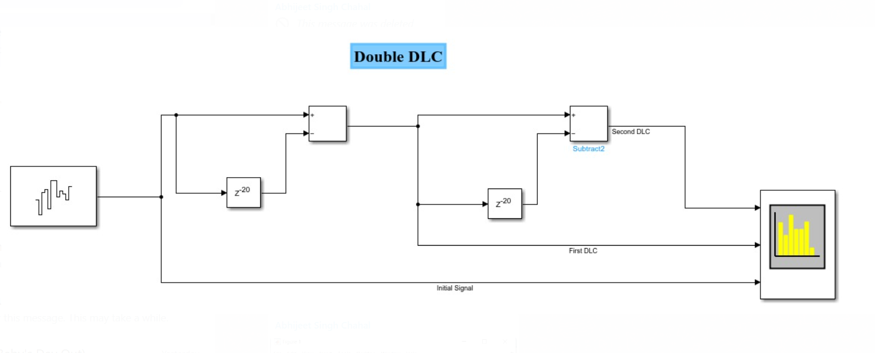
SIMULATIONS
SIMULATIONS

Slide 10
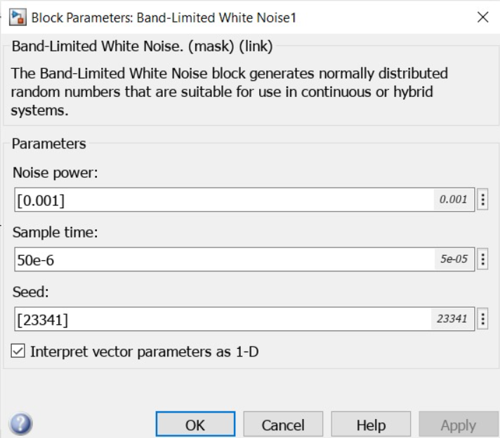
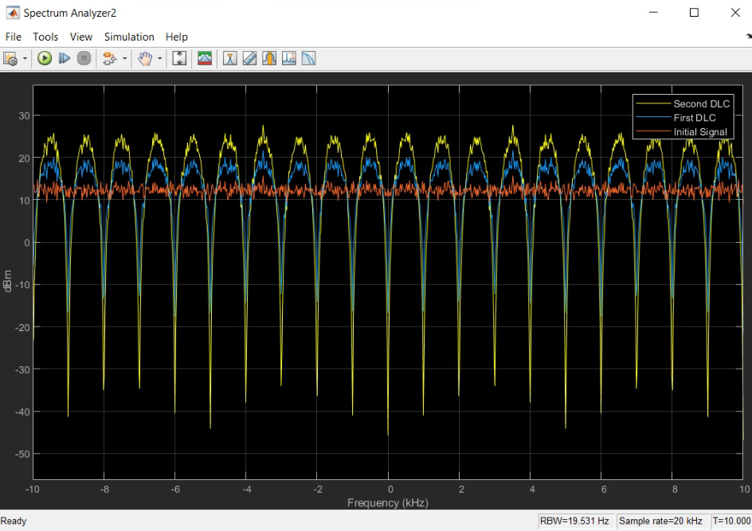
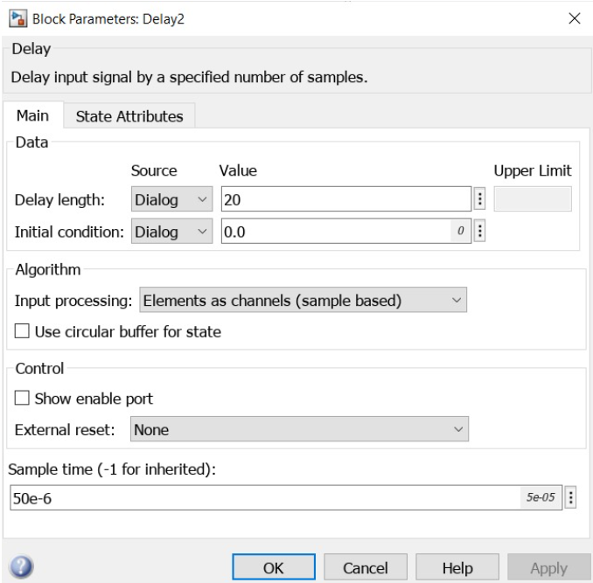
Simulation of DLC on white Gaussian noise:

Slide 11
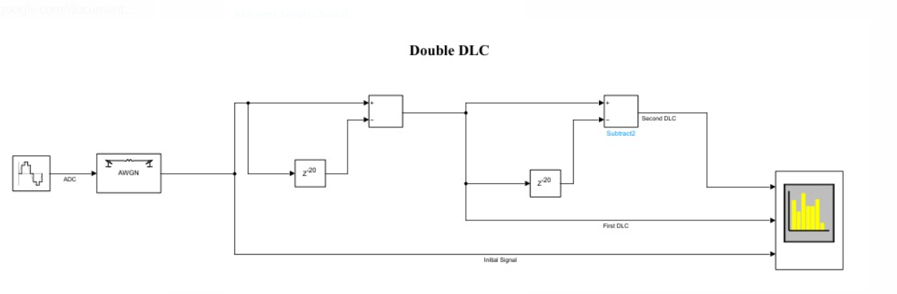
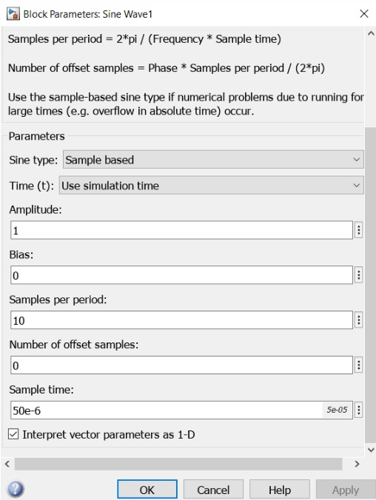
Response of sinusoidal echo in the presence of AWGN noise

Slide 12
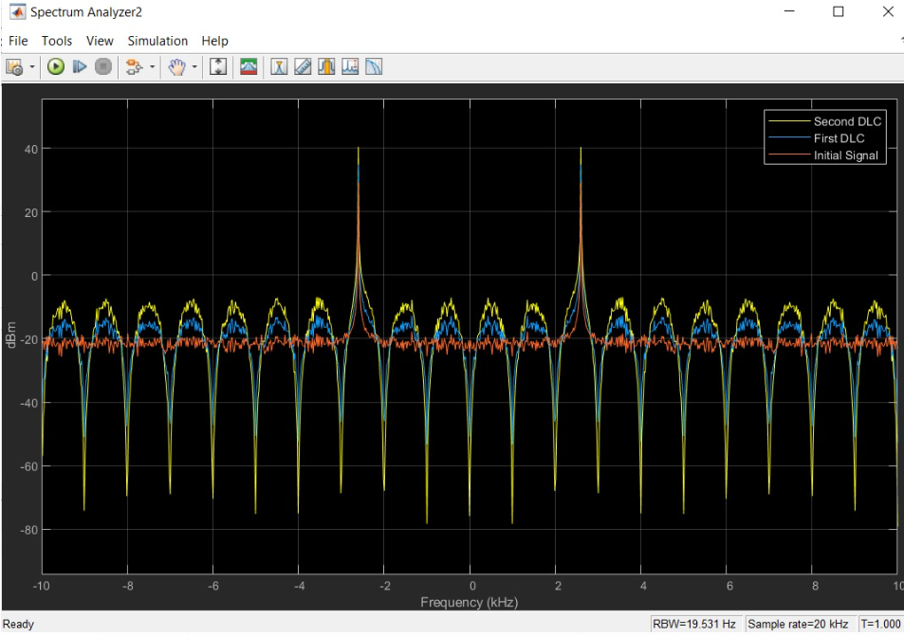
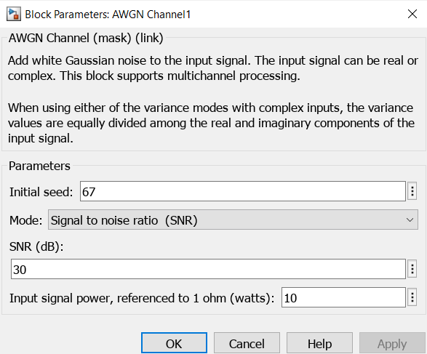

Slide 13
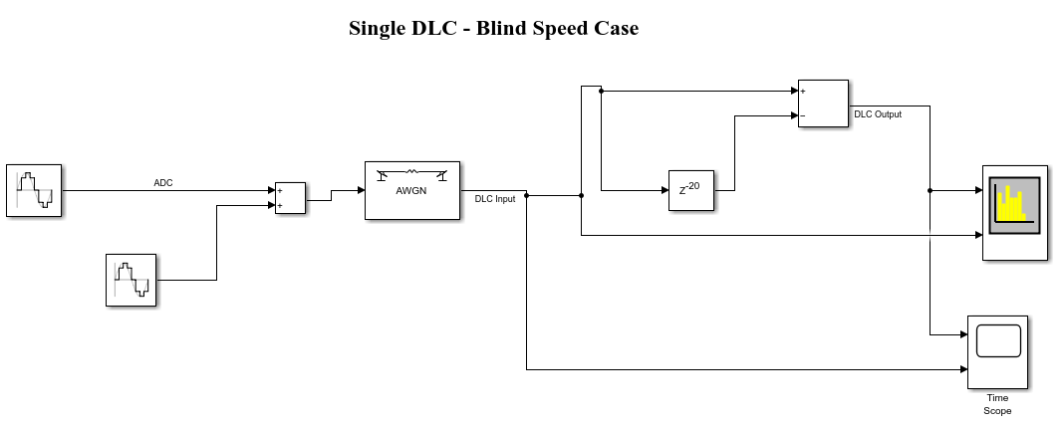
Echo is at blind speed (Single DLC)

Slide 14
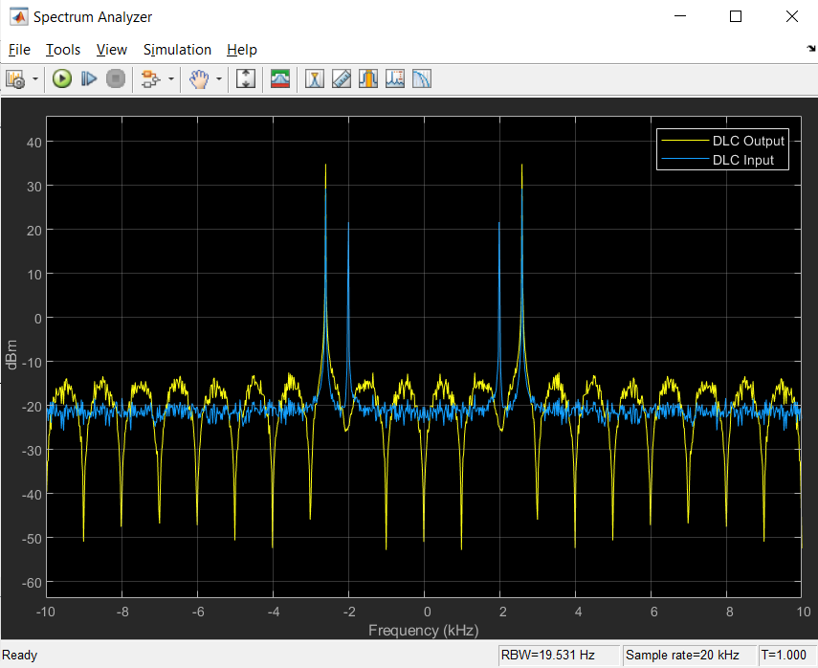

Slide 15
Clutter Attenuation
Clutter attenuation refers to reducing or eliminating unwanted signals in radar systems, which can interfere with detecting the desired target signals. One way to accomplish this is by using the Delay Line Canceller.
clutter power spectral density is represented by a Gaussian function and is written as.
W(f)=W₀ exp(- f ²/ 2σ_{c}²) = W₀ exp(- f ² λ²/ 8σ_{v}²) f ≥0
Where W₀ = peak value of the clutter power spectral density, at f=0, σ_{c}= standard deviation of clutter spectrum in hertz, σ_{v}= standard deviation of the clutter spectrum in meters/second

Slide 16
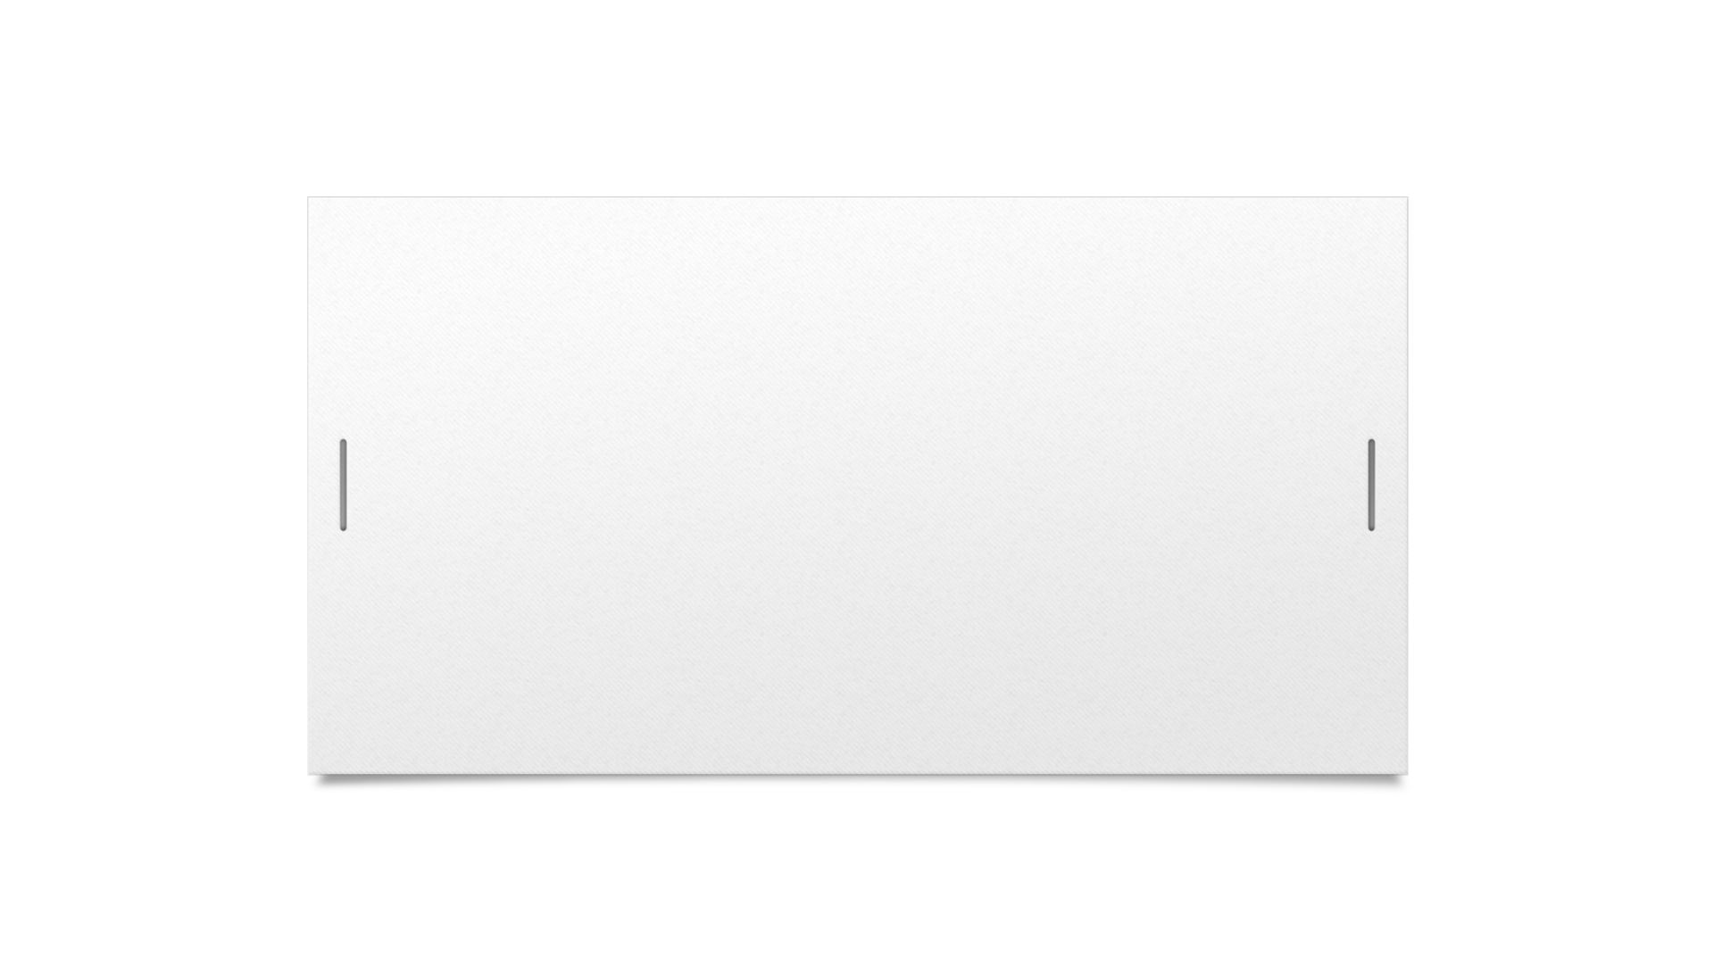

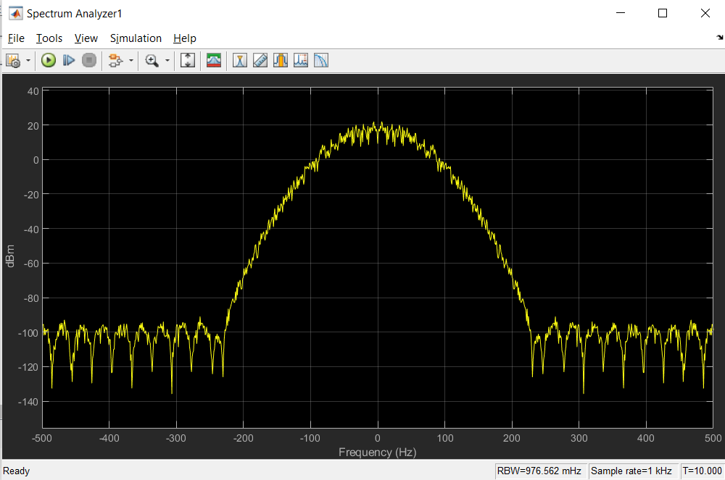

Clutter Attenuation

Slide 17
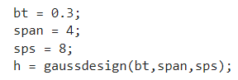
Clutter Attenuation
To simulate a clutter signal that is described by a gaussian power spectral density, we did the following:
1) Generate band-limited white noise
2) Filter it with a discrete gaussian filter
To create the gaussian filter, we ran the following code:

Slide 18
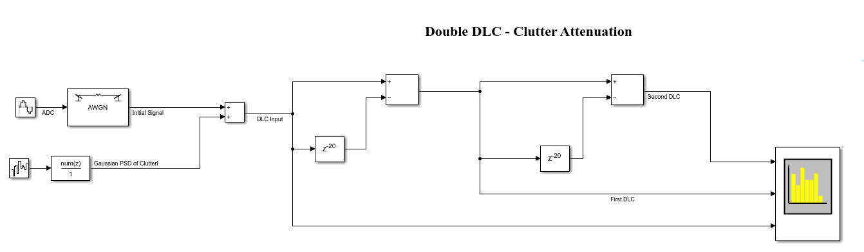
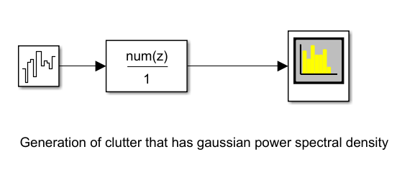
Copy the filter coefficients generated in ‘h’ to the discrete FIR filter block.
Combining all the effects, we have the following final block diagram:

Slide 19
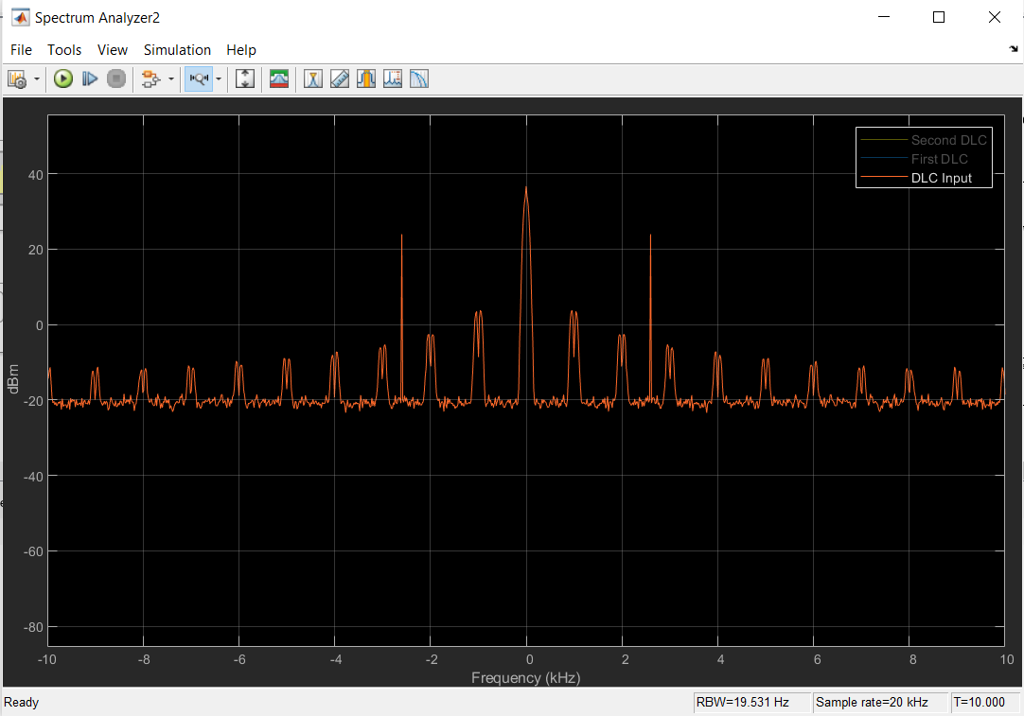
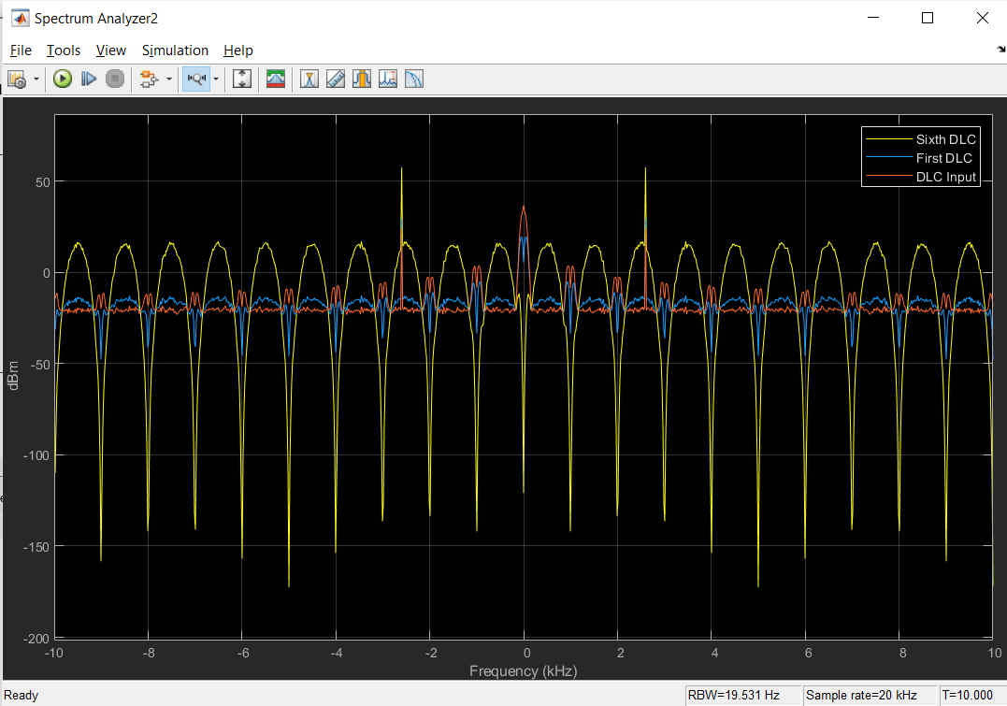
Input and Output Plots

Slide 20
Conclusion
In conclusion, Delay Line Cancellers (DLCs) are a powerful tool for removing unwanted clutter from radar signals. Through the use of Simulink simulations, we have seen the effectiveness of DLCs in attenuating clutter caused by an AWGN channel. Additionally, we have explored the impact of blind speed on the performance of DLCs and how different orders of DLCs can affect the clutter attenuation of the filter.

Slide 21

Thank You

